Slide 1








SCOPE : HAMR eyecloud - AA

Slide 2
Introduction
Context & Stake
Context
Build an active / active calculation platform on both datacenter aws Ireland and aws Canada.
Stake
Ongoing Support group strategy for having a central platform.

Slide 3
Reminder of the process
Steps
Description
Actors
Deliveries
Business Overviews
Viet
Context Stake and Goals .
Expected Benefits / Success criteria's.
Desired deliveries dates and priorities
Viet / L.TCHAMFONG
Reviews J.Phillipe.
Resume context/stake and acceptance deliveries
Scoping / Requirements / Epics
Resp. Viet …
Perimeter , Scoping and hypotheses per components.
Define Matrix of components
Define technical's requirements ..
L.TCHAMFONG Viet J.NGUEN
Marc.B
JP. Lee
F.JEAN
-Scoping documents.
-Epics stories Details
Global Architecture Document
Resp. L.TCHAMFONG
Define scenarios for each steps
L.TCHAMFONG Viet J.NGUEN
Marc.B
JP. Lee
F.JEAN
Applications Designs
Charge / Resources Organizations
Resp. L.TCHAMFONG
Defined charge / charge plan based on the technical specifications and defined architecture
Define required resources
L.TCHAMFONG
Reviews: Viet
Costing components
Materials resources
Assigns human resources
Direction / Planning
Resp .Viet
Define direction / lots
detailed project plan .
L.TCHAMFONG
Reviews: Viet
Direction + Project plan
Implementation /Realization
Resp. L. TCHAMFONG
Enhancement on impacted components.
RIDE
RIOS
CCOE
Setup
Change Management
Resp. Viet
Define change management strategy and operational training plan
Viet
Change management plan

Slide 4
Current Architecture

Slide 5
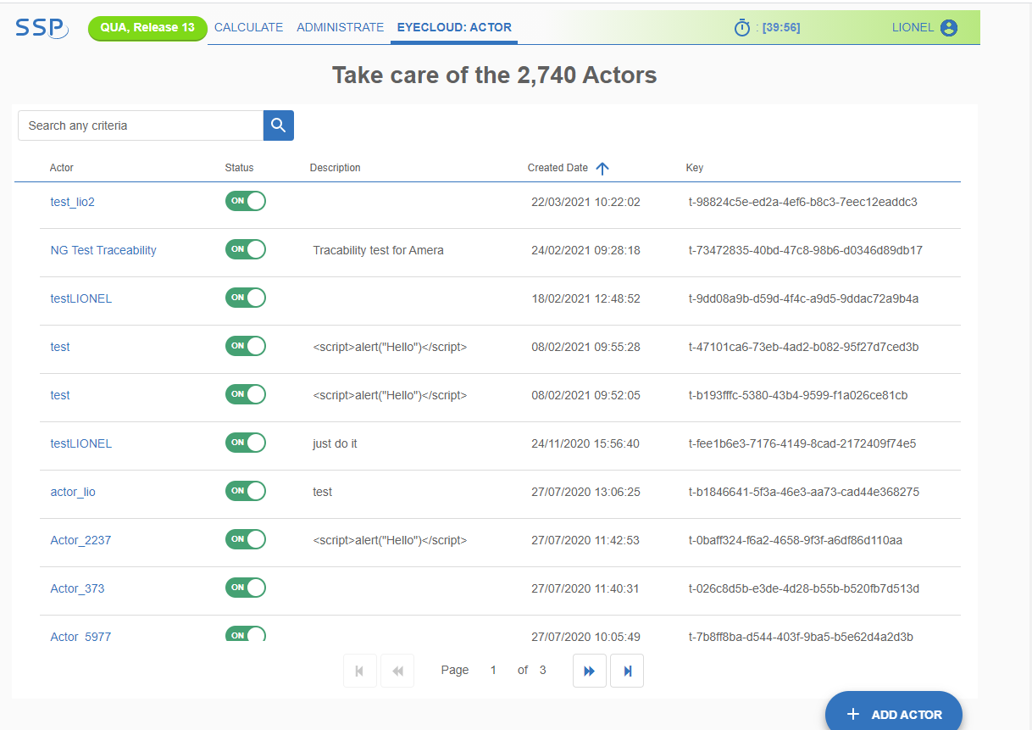
Administrative API : current Architecture
SSP
R53
Get Applications / create new application / update Application
Get Actors / Create new actor / Update an actor
etc...
ALB int
Application Management
Actor Management
ASG
Filetype Management
MySQL

Slide 6
Functional API : Current Architecture with Eyecloud V2
Orchestra
Inlab
Rx.Net
B2B portal
Walmann
OnSight
Orchestra
Inlab
Rx.Net
B2B portal
Orchestra
Inlab
Rx.Net
R53
Get ECID
Post data/document
Get data/document
ALB int
ALB ext
Provides of unique ECID on the fly | batch mode
Stores (POST) document / metadata
ASG
Provides (GET) document / metadata
Authentication Authorization
MySQL
Dynamo DB
S3

Slide 7
Target Goal

Slide 8
Functional Scope Step 1
Eyecloud V2
with the current Architecture
Eyecloud V3 with the new architecture
Multiple ID Types (UEID, ULID,UFID, UOID) with the V2
Unique ID Type with the V3 and uniqueness reinforcement
Current Users are using V2
Current and new Users will use V3 to get and create new IDs
Today
Tomorrow

Slide 9
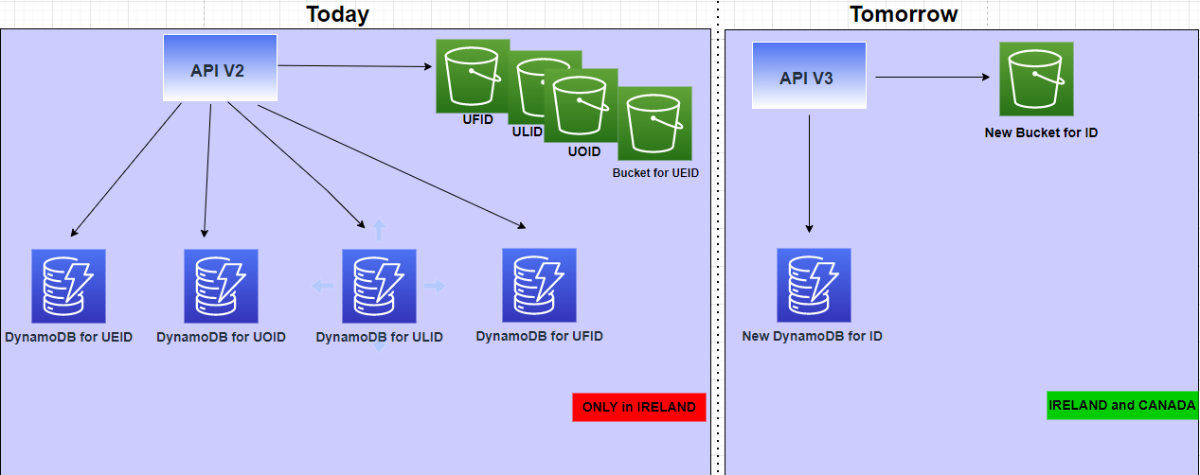
Current Version Vs future version (relation with storage/DB components)

Slide 10
Functional Scope Step 2
Eyecloud V2
with the current Architecture
Eyecloud V3 with the new architecture
Authentication will work either with API keys or with Oauth2 process*
Authentication and Authorization are working with Actor/Application Keys
Authorization will work with Authz Component
Today
Tomorrow
*depending on the study (in progress) on the GDP authentication. EyeCloud will reuse the same mechanism

Slide 11
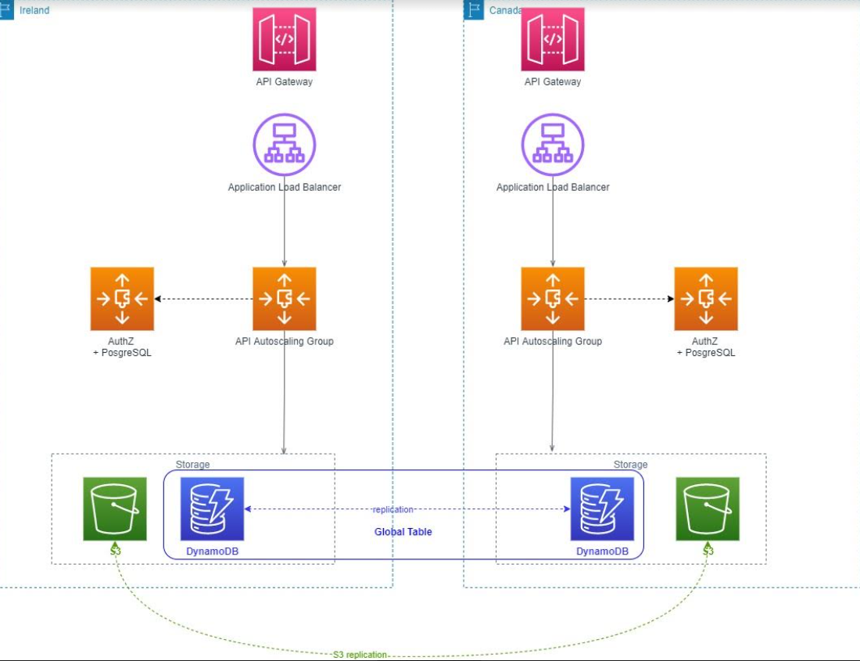
Setting an High Availability Multi Region (HAMR) API on AWS

Slide 12
RoadMap and scheduling

Slide 13
2021 |  | 2022
November | December | Q1 | Q2 | Q3 | Q4
Scoping STEP
Conception and Realization STEP 1
Route 53
Scoping / Requirements
ASGs duplication
S3 Replication
Global table in Dynamo DBs
I
Id uniqueness enhancement
Discussion with users
Realization
Conception and Realization STEP 2
Authentication
Authorization

Slide 14
Details of different steps

Slide 15
Route 53
Current Situation | Target Situation | Solutions | Constraint
Today, Route 53 routes only to Ireland As we have only one region | The goal is to route to both region depending on the latency | INFRA SIDE set Cname definition (DNS) for each region Set the traffic Policies : Which metrics have we to consider for failure Which actions have we to execute

Slide 16
ASGs duplication
Current Situation | Target Situation | Solutions | Constraint
Today, we have only ASGs in Ireland | The goal is to duplicate ASGs in canada | INFRA SIDE Creation of EC2 instances Creation of ASGs APPLICATION SIDE Creation of dedicated Pipelines to deploy in Canada ASGs

Slide 17
S3 Buckets
Current Situation | Target Situation | Solutions | Constraint
Today : We have S3 bucket in only Ireland region The region is present in the S3 path which is saved in“location” column in the dynamo DB | Goal is to : Having S3 data in both Canada and Ireland | INFRA SIDE Set bidirectional replication (RTO ~ less than a minute) APPLICATION SIDE Set in the application Side the bucket Path (not in the dynamo DB value anymore) as an SSM key. This way we ensure that a request from a dedicated region will hit the dedicated S3 bucket.

Slide 18
ID uniqueness
Current Situation | Target Situation | Solutions | Constraint
Today, we have 4 pattern for ID and dynamo DB for each : ueid : AAANAAAA uoid : A*N*A*N* ufid: AA**NN ulid : ******** | Goal is to : Ensure the uniqueness of the generated ID have One unique Id type (UOID) | INFRA SIDE Set the Global Table feature : Configuration of Global table on each dynamo DB table ensure that we have the same table in each Region. Create an additional Dynamo DB for the new pattern ID (V3) APPLICATION SIDE Ensure not to generate the same id different solutions : Build a Unique ID Generator Using AWS DynamoDB (timestamp, at least 10 characters) or Add a prefix with the notion of Region (CA, IR) or put in place the case sensitive | Ensure that the end users will be able to consume the new ID format

Slide 19
Authentication
Current Situation | Target Situation | Solutions | Constraint
Today usage of Application_key and actor_key as headers | Goal is to have more secure method by using ApiGateway | INFRA SIDE : Set the API gateway service in order to provide and manage API keys for Users Api security (cf ext slides) : Api key mechanism Users simply call the resource with API keys which rotate frequently or oauth2 : Users call the ApiGateway and get a Token then, users call the resource with the token provided before | Api key mechanism : Not so secure because anybody who know the api key could call the resource, but easier to put in place oauth2 : More secure but not so easy to put in place because users has to evolve in order to call the provider first to get the token, and then call the API.

Slide 20

Authentication solution 1 : APi Key Mechanism
Api Key validation (2)
Eyecloud API
Calling System
Call the API Gateway with API key (1)
Call to the API with the validated API key (3)
API Gateway
Response to the Caller (5)
Response to the APi Gateway (4)

Slide 21
Authentication solution 2 : Oauth2 Mechanism
ID Provider
like Cognito
token generation (2)
valid token (3)
Calling System
Call from the caller to get access Token (1)
API Gateway
response with valid Token (4)
Eyecloud API
Call from the caller with access Token (5)
Call the Eyecloud API (6)
Response to the caller (8)
Response to the APi Gateway (7)

Slide 22
Authorization and permissions
Current Situation | Target Situation | Solutions | Constraint
Today usage of Circle : FileTypes are affected to Circle Actors are associated to circle in order to use the dedicated fileType with the good permissions (Read or Write) | Goal is to use Authz to manage authorization | INFRA SIDE Creation of Dedicated ASGs Creation of Posgres DB APPLICATION SIDE Cf next slides

Slide 23
Authorization : Eyecloud Objects interaction → Current Situation
Application 1
Actor 1
Actor 2
Actor 3
FileType 1 : Read / Write
FileType 1 : Read / Write
FileType 1 Read / Write
FileType 2 : Read / Write
FileType 2 : Read / Write
FileType 2 : Read / Write
FileType 3 : Read / Write
FileType 3 : Read / Write
FileType 3 : Read / Write
FileType 1
FileType 2
Metadata
FileType 3
Circle

Slide 24
Authorization : Eyecloud Objects interaction → Target Situation with Authz (proposal)
Application 1 (Organisation)
Actor 1 (Client Application 1)
Actor 2 (Client Application 2)
Actor 2 (Client Application 2)
FileType 1 : Read / Write
FileType 1 : Read / Write
FileType 1 : Read / Write
FileType 2 :Read / Write
FileType 2 :Read / Write
FileType 2 :Read / Write
FileType 3 : Read / Write
FileType 3 : Read / Write
FileType 3 : Read / Write
FileType 1 (Permission 1)
FileType 1 (Permission 1)
FileType 1 (Permission 1)
FileType 2 (Permission 2)
FileType 2 (Permission 2)
FileType 2 (Permission 2)
FileType 3 (Permission 3)
FileType 3 (Permission 3)
FileType 3 (Permission 3)
Example of permissions :
{"Tracability": "w"}
{"Tracability": "r"}
{"RxML file": "w"}
{"RxML file": "r"}

